Slide 1

TEXT CLASSIFICATION – TEAM10
Presented by,
DEEPANRAJ ARUMUGAM MURUGESAN
KEERTHIVASAN SURYANARAYANAN
RANJITKUMAR SETHURAMAN
SRUTI SRIRAM

Slide 2

DATA AND CLASSIFICATION MODELS USED
Books: Macbeth, The Sea-Gull, Pride and Prejudice, Dracula, An Enemy of the People
ML Models: Logistic Regression, Decision Tree Classifier, Random Forest Classifier, SVM(Support Vector Machine), XGBoost
Applied various methods like Cross Validation, Stemming, Lemmatization, BOW and tf-idf on all 5 classification models.

Slide 3
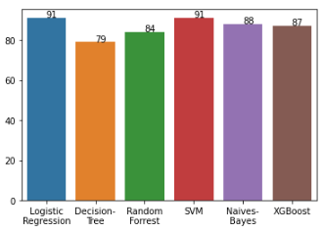
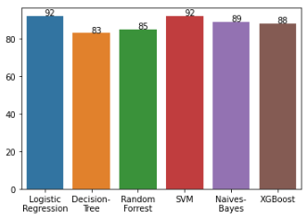
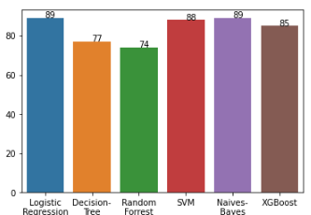
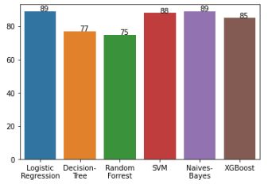
VISUALIZATION
STEMMED DATA WITH TF-IDF
STEMMED DATA WITH BOW
LEMMATIZED DATA WITH BOW
LEMMATIZED DATA WITH TF-IDF

Slide 4
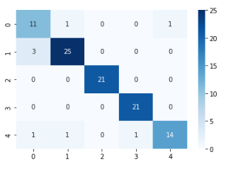
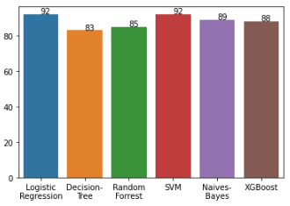
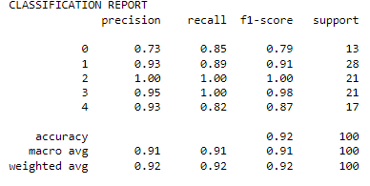
CHAMPION MODEL
LOGISTIC REGRESSION (STEMMED DATA WITH TF-IDF)

